Slide 1
June 2025
PhD Updates

Slide 2
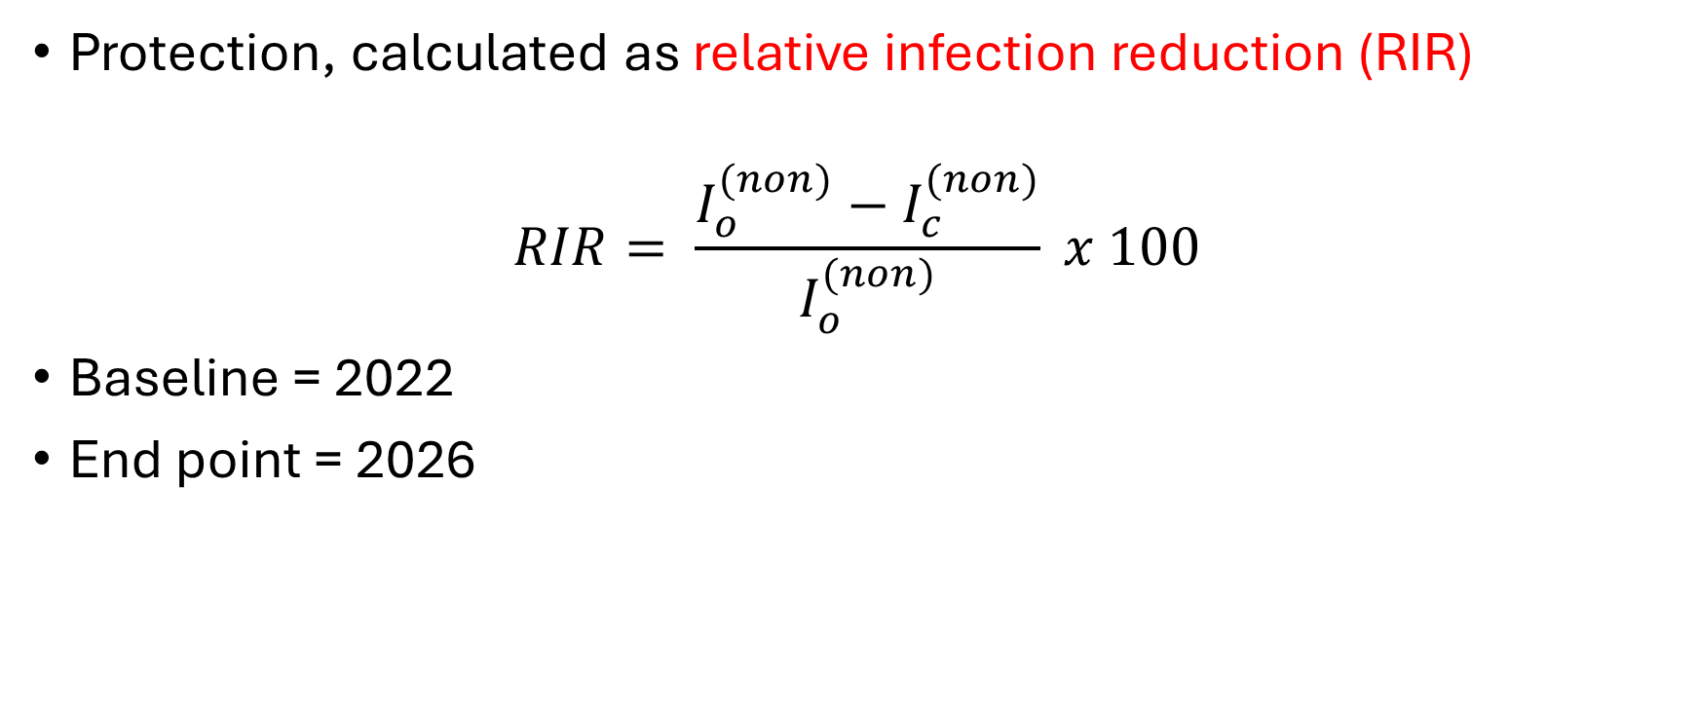
Community protection – assessing the relationship between intervention coverage and impact
Protection, calculated as relative infection reduction (RIR)
$$RIR= \frac{I_{o}^{(non)}−I_{c}^{(non)}}{I_{o}^{(non)}} x 100$$
Baseline = 2022
End point = 2026

Slide 3
Steps
Using existing simulation output
Fix all other inputs (e.g., LLIN, IRS, Vaccine) at their mean or policy-relevant values.
Vary SMC coverage from 0.2 to 1.0 (or even 0 to 1).
Predict the impact using the GP
Focus on severe cases reduction for SMC and vaccine
SMC and vaccine are age-based administration interventions
Able to identify users and non-users by age_group
Focus on one setting – Oti

Slide 4
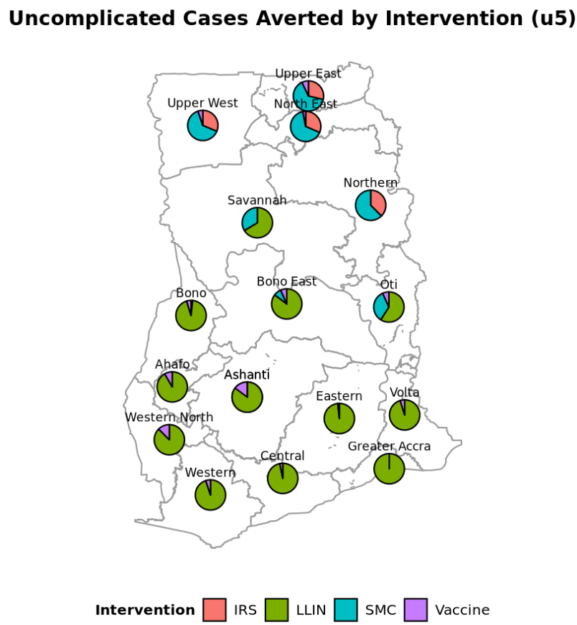
Oti with 3 interventions

Slide 5
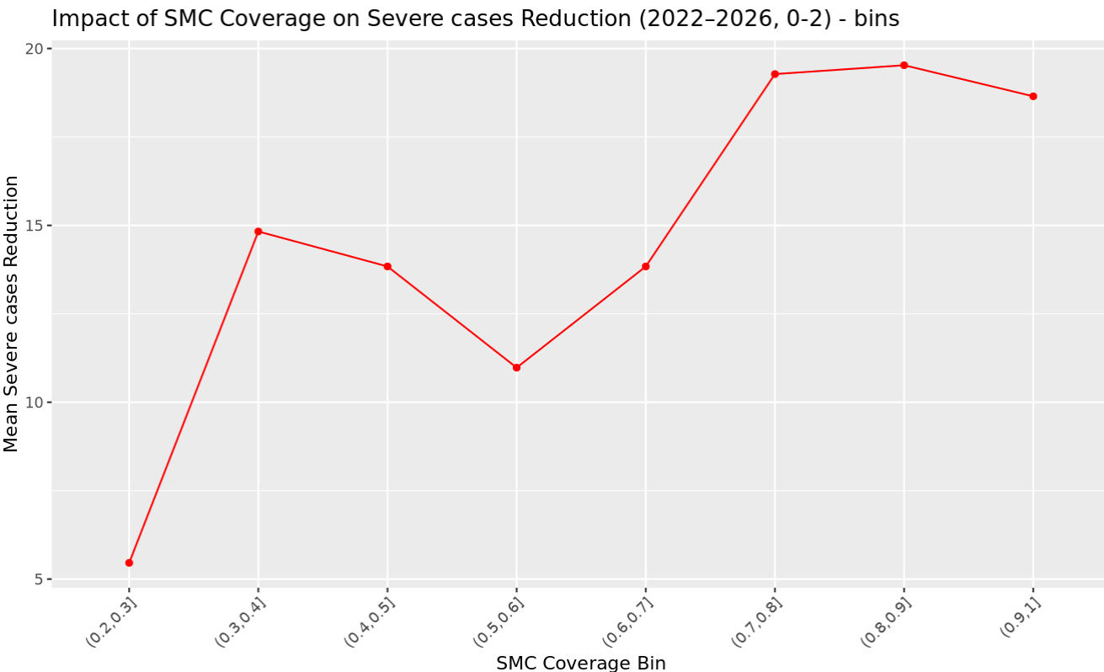
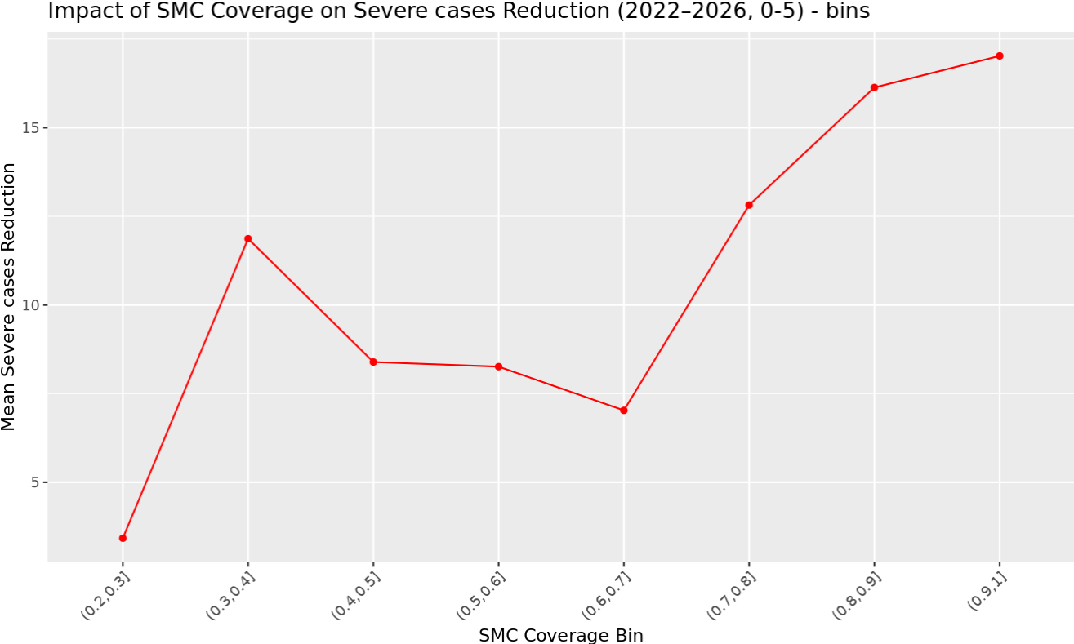
SMC coverage vs severe cases reduction for age groups 0-2 and 0-5
Observe a non-monotonic relationship in both interventions

Slide 6
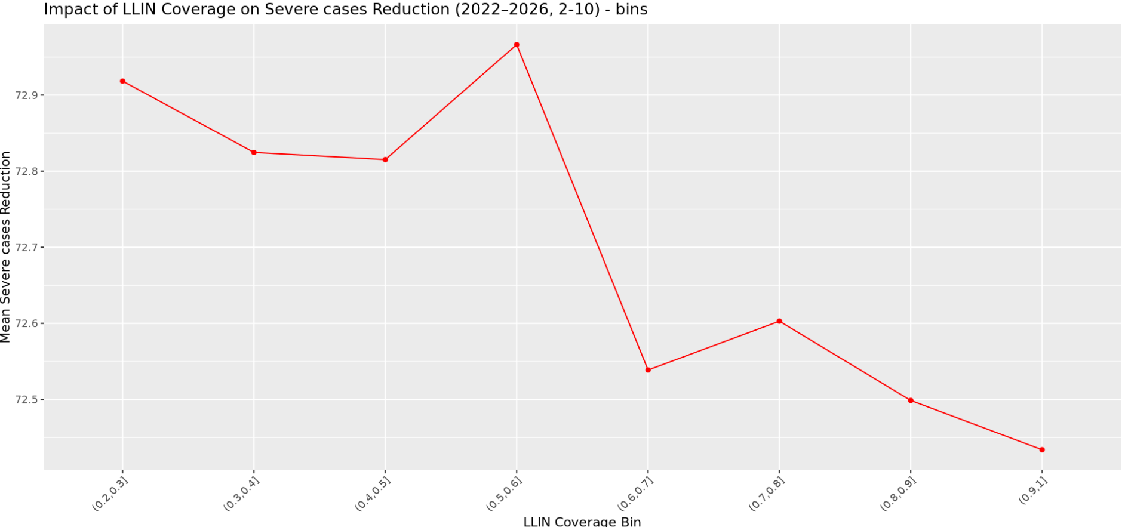
Accra with only LLIN

Slide 7
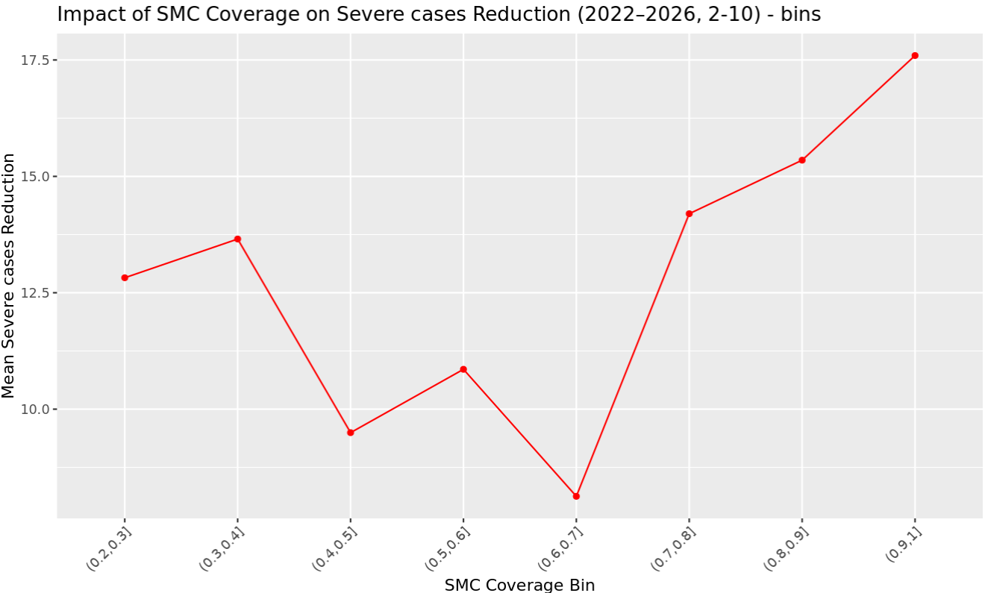
SMC coverage vs severe cases reduction for age groups 0-2 and 2-10

Slide 8
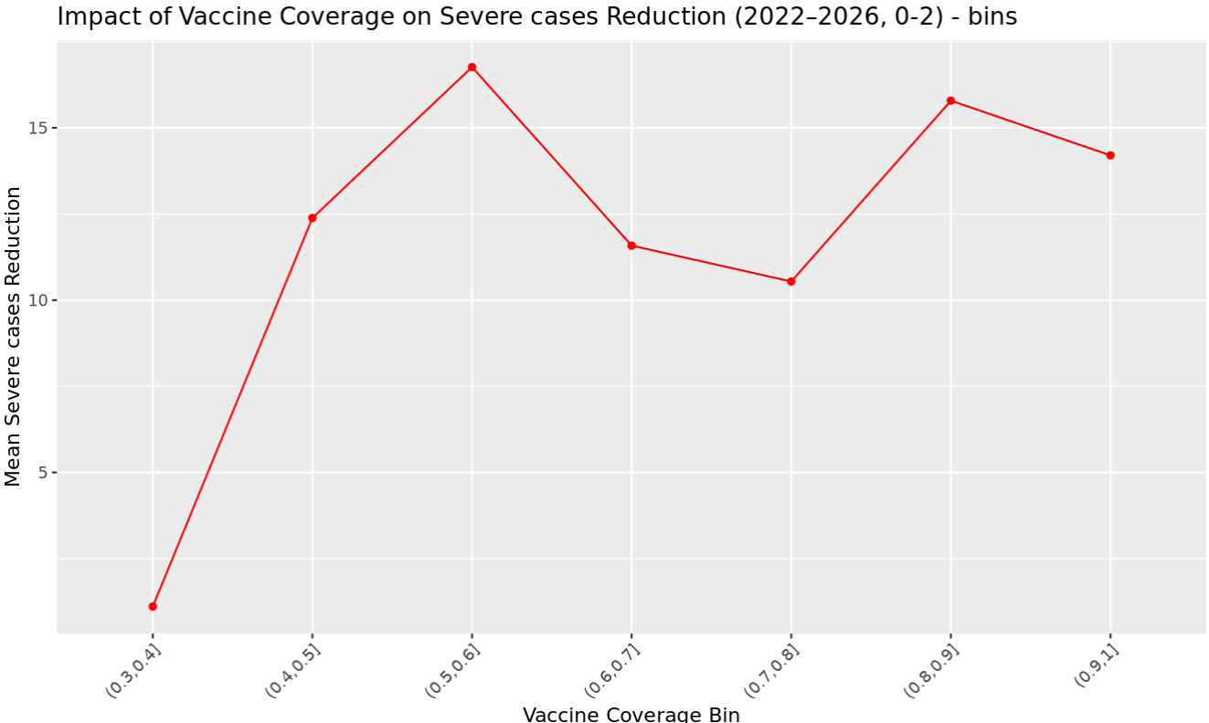
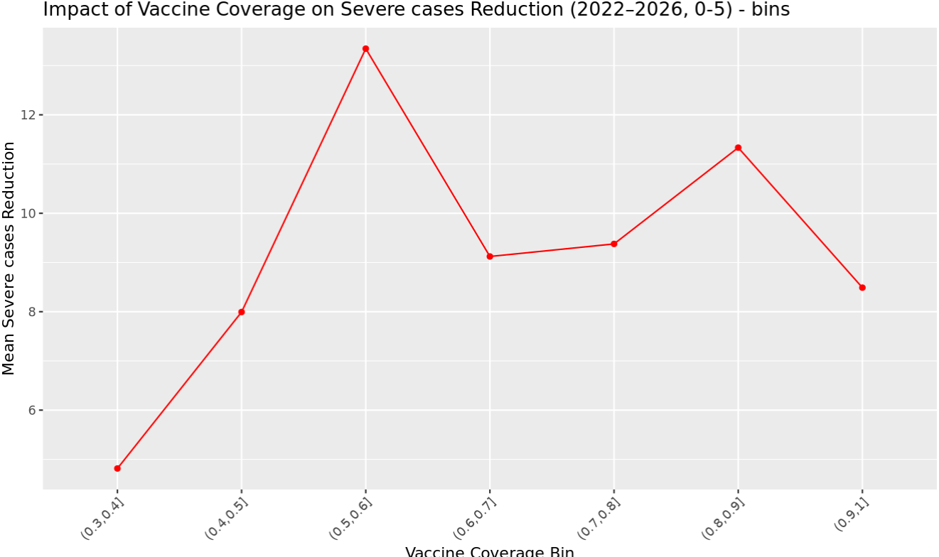
Vaccine coverage vs severe cases reduction for age groups 0-2 and 0-5

Slide 9
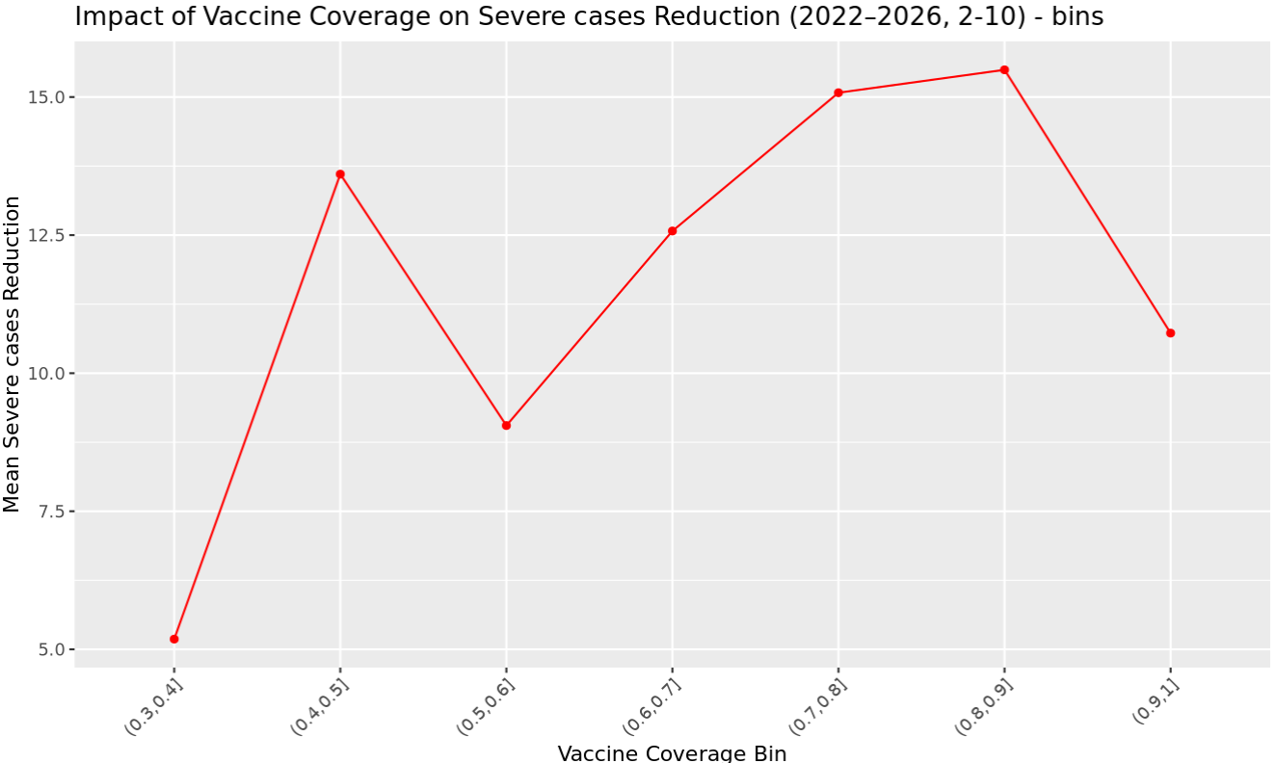
Vaccine coverage vs prevalence /severe cases reduction for age groups 2-10 and 0-2
Vaccine primary target age group (0-2) vs non-users (2-10)

Slide 10
Next?
Adjust age groups for u5 and ov5 in next simulation
Use calibrated EIR for each setting (not varied)
Use a sequence of points within coverage range (no LHS)
Fix all other interventions and focus on one for the simulation? Eg: LLIN is already known
IRS and LLIN? Users and non-users

Slide 11
Next?
Break down plot by:
EIR level (low vs high)
LLIN coverage level (<50% vs 50-80 vs >80%)

Slide 12
